Slide 1
Class Project OPIM 5272
House Rabbit Connection
Student’s names
4/27/2016

Slide 2

House Rabbit Connection Background
The House Rabbit Connection of Massachusetts & Connecticut is a nonprofit, tax-exempt 501(c)(3) corporation (founded in 1997) and licensed chapter of the House Rabbit Society.
All volunteer animal welfare organization
Mission Statement
“To take in adoptable abandoned rabbits, provide foster care, have them spayed or neutered and find quality, indoor homes for them while also educating the public and other organizations about rabbit care.”
Lead by 15 board members which may hold any one of these positions
6 Officers (President, Vice President, Clerk, Co-clerk, Treasurer, Co-treasurer
7 Committee Chairs
Typically will adopt 20- 40 rabbits annually
Distribute 50 – 100 Rabbit Guides

Slide 3












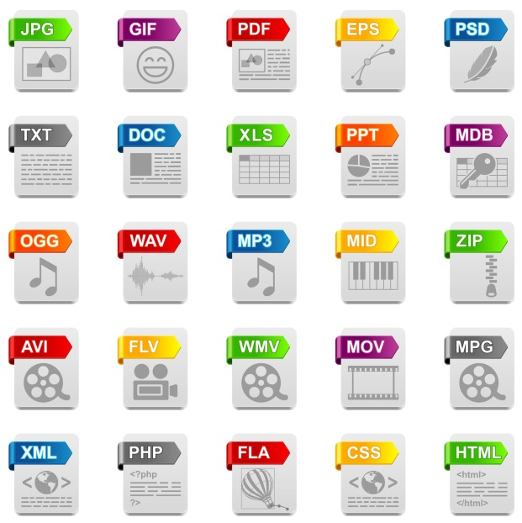







Adoption Process
Customer:
adopter
Call HRC
Information captured not always in the same format i.e. (phone number 123-456-7890 vs (123) 456-7890
Sometimes information isn’t complete emails are often missed
Triggering Event
ME
VT
Educate Caller
NY
NH
MA
CT
Information is transferred from email to access database duplication of effort
Only 1 user has access to database
Adoptions:
Interview Caller
29
25
31
2015
2014
2013
Stakeholders:
Adoption Chair and Foster chair using their own spreadsheets lag in the information being accurate
Adoption chair manually tallies adoption counts
Hopline Educator
Meet & Greet
Clerk
Adoption Chair
Foster Chair
Foster
Adopter info captured on paper document needs to be transferred to database
Time lag- scanned word doc not always sent to clerk
Complete Paperwork
Adoption Representative
Treasurer
As Is Process Map in Appendix

Slide 4







Database Model
Primary Key
Foreign Key
Full Database Model View in Appendix
Table Model
Adopter
FosterRabbit
Vet
Is adopted by adopter
Adopter_ID
Rabbit_ID
Vet_ID
Is spay/neutered by vet
Additional Info…
Org_ID
Additional Info…
Vet_ID
Adopter_ID
Foster Site
Foster_ID
Organization
Is given by organization
Is cared for by Foster
Foster_ID
Org_ID
Additional Info…
Additional Info…
Report Request:
1
2
3
4
5
Number of rabbits adopted monthly
Number of rabbits taken in monthly by Org
Number of active foster sites
Follow up memo for user inputted rabbit
Vet usage for newsletter

Slide 5



Business Value Provided by the Database
timeliness
Accuracy/Completeness
Duplication
Hopline Educator
Real time updates of available rabbits
Area for email to be entered as a reminder to capture info
Remove entering the caller info twice once on email once in the database
Improve time to send out packets information available sooner
Reduce the chances to make mistakes re-entering info from email
Remove the need to enter info twice- once for the caller once for the adopter
Clerk
Adopter information available sooner
Follow up report to keep follow up on track
Reduce the manual tracking for reporting purposes
Adoption chair
Remove the need to scan adoption paperwork for database updates
Treasurer

Slide 6
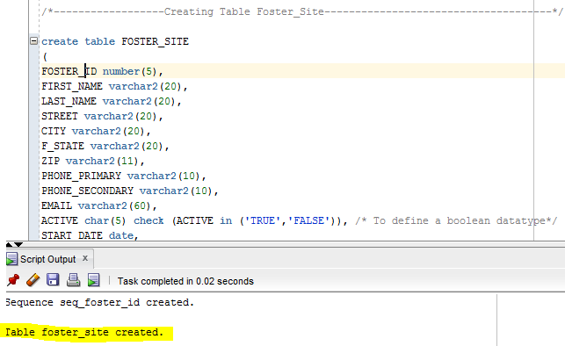
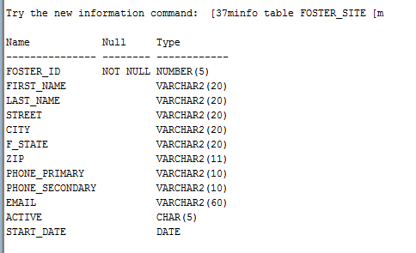
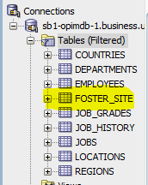
Database Demonstration
Table created with the CREATE TABLE statement
Contents
Table Creation
SQL Reports
Sequence function
Table Structure Verified
Database Schema Updated

Slide 7
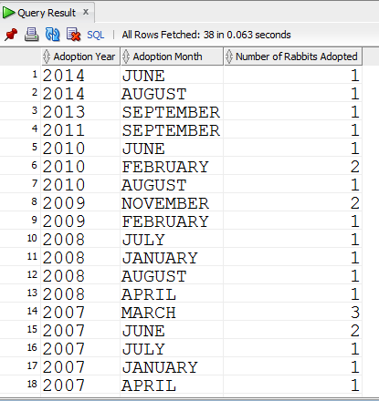
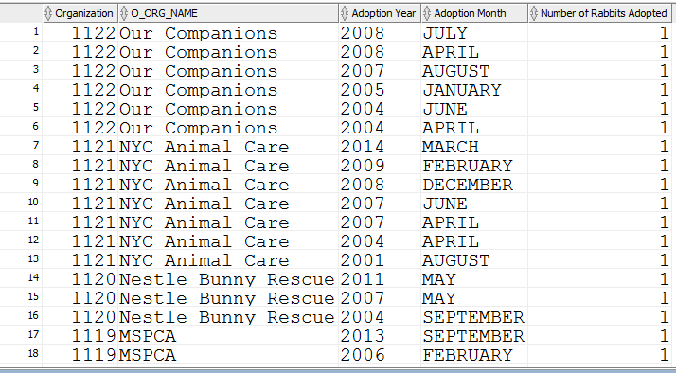
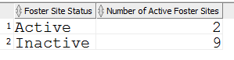
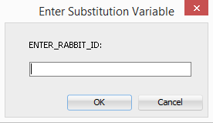
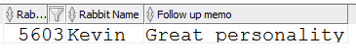
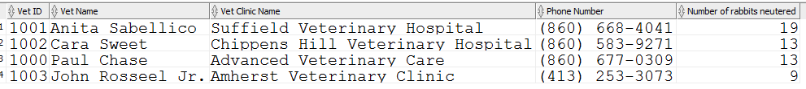
Database Demonstration
# of Rabbits adopted by Year and Month
# of Rabbits transferred from an organization by year and month
Contents
Table Creation
SQL Reports
Sequence function
# of Active and Inactive Foster Sites
Bring up the Follow Up Memo for a Rabbit
Number of rabbits neutered by each Vet ordered by count

Slide 8
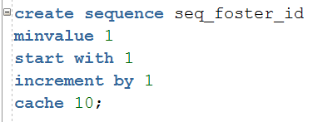
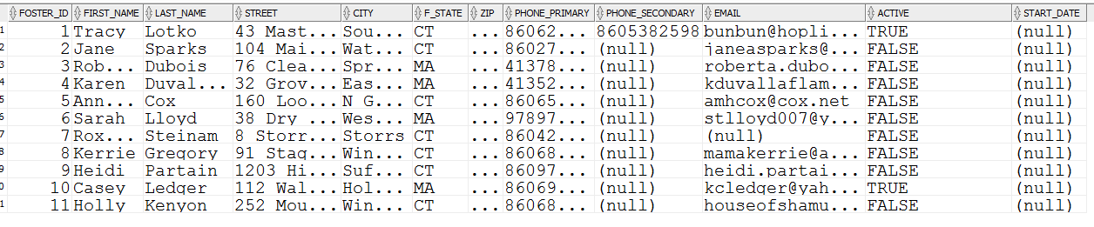
Database Demonstration
Sequence created with CREATE SEQUENCE command
Contents
Table Creation
SQL Reports
Sequence function
Sequence starts at 1, increments by 1
NEXTVAL steps to the next value automatically every time it is executed with any sequence.
This gives us an auto-incrementing value which has been used as a primary key.

Slide 9
Appendix

Slide 10
As Is Process Map To Be Process Maps

Slide 11
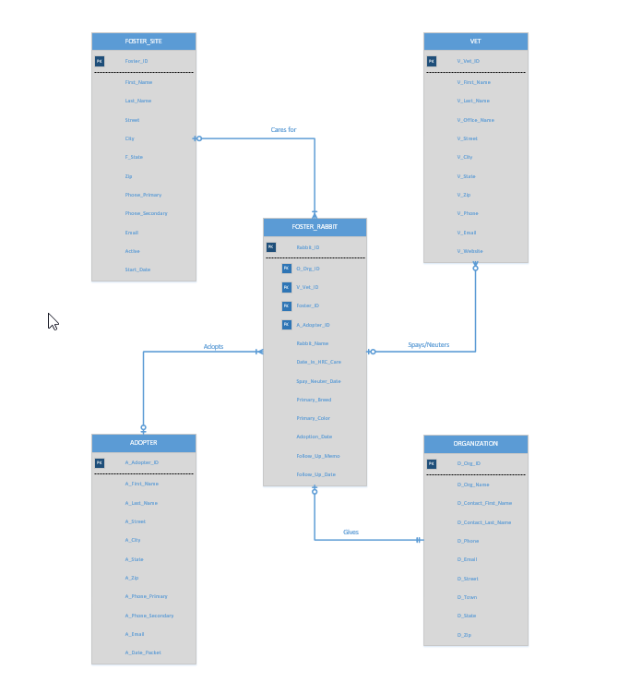
Database Model- Place Holder

